Slide 1
OSPF Protocol & Socket

Slide 2
OSPF Protocol
OSPF is a routing protocol used in computer networks to distribute routing information between routers. It's an efficient way to ensure data packets reach their destination.
OSPF, or Open Shortest Path First, is a link-state routing protocol that uses a sophisticated algorithm to calculate the optimal path for data packets. It's a popular choice for large networks, where its efficiency and scalability are crucial.
OSPF uses a hierarchical structure to organize and manage large networks. This hierarchy allows for efficient routing updates and reduces network traffic.
Autonomous System (AS): A collection of networks under a common administrative domain. AS boundaries are defined by AS numbers, used to identify different networks.
Areas: Networks are divided into areas to segment traffic and improve performance
Backbone Area: The central area of the network, connecting all other areas and handling inter-area routing.

Slide 3
1
Interior Gateway Protocol
2
Link-State Routing
OSPF is designed for use within a single autonomous system, handling routing between routers within a network.
Each router maintains a complete map of the network, allowing it to make informed routing decisions.
3
Shortest Path Calculation
4
Scalability
OSPF utilizes Dijkstra's algorithm to determine the shortest path between routers, ensuring efficient data transmission.
OSPF can handle large networks with numerous routers, ensuring reliable routing in complex environments.

Slide 4
OSPF Operation
OSPF operates through a series of steps, starting with routers discovering their neighbors and exchanging link-state information. This information is used to build a comprehensive network map.
Neighbor Discovery
1
Routers send out hello packets to identify their neighbors and establish communication channels.
2
Link-State Information Exchange
Routers flood their link-state information, including network topology, link costs, and network addresses, to their neighbors.
Database Synchronization
3
Routers build a complete network map using the received link-state information, ensuring consistency across the network.
4
Shortest Path Calculation
Routers employ Dijkstra's algorithm to calculate the shortest path to every other router in the network.
Routing Updates
5
When link-state information changes, routers propagate the updated information to their neighbors, ensuring dynamic route adjustments.

Slide 5
OSPF Packet Types
OSPF uses different packet types to exchange routing information between routers. These packets are used for neighbor discovery, link-state information updates, and other essential routing tasks.
Hello
Neighbor discovery and keepalives
Database Description (DBD)
Exchanging link-state database information
Link-State Request (LSR)
Requesting missing link-state information
Link-State Update (LSU)
Updating link-state information
Link-State Acknowledgment ( LSA)
Acknowledging received link-state information

Slide 6
FORMAT – in PDF

Slide 7
SOCKET
A socket is one endpoint of a two way communication link between two programs running on the network.
socket mechanism provides a means of inter-process communication (IPC) by establishing named contact points between which the communication take place.
Like ‘Pipe’ is used to create pipes and sockets is created using ‘socket’ system call
The socket provides bidirectional FIFO Communication facility over the network. A socket connecting to the network is created at each end of the communication. Each socket has a specific address. This address is composed of an IP address and a port number.

Slide 8
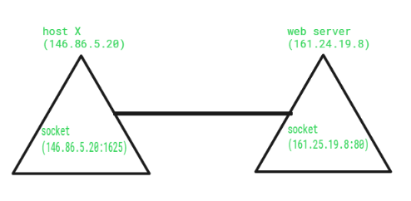
Socket are generally employed in client server applications.
Types of Sockets : There are two types of Sockets: the datagram socket and the stream socket.
Datagram Socket : This is a type of network which has connection less point for sending and receiving packets. It is similar to mailbox. The letters (data) posted into the box are collected and delivered (transmitted) to a letterbox (receiving socket).
Stream Socket In Computer operating system, a stream socket is type of interprocess communications socket or network socket which provides a connection-oriented, sequenced, and unique flow of data without record boundaries with well defined mechanisms for creating and destroying connections and for detecting errors. It is similar to phone. A connection is established between the phones (two ends) and a conversation (transfer of data) takes place.

Slide 9
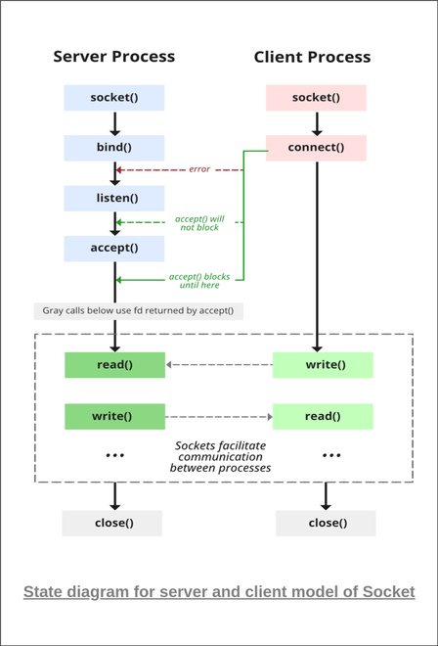
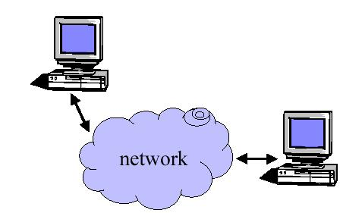
Provides an abstraction for interprocess
communication
The services provided (often by the operating
system) that provide the interface between
application and protocol software.

Slide 10
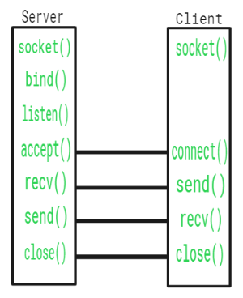

Slide 11
Function Call | Description
Socket() | To create a socket
Bind() | It’s a socket identification like a telephone number to contact
Listen() | Ready to receive a connection
Connect() | Ready to act as a sender
Accept() | Confirmation, it is like accepting to receive a call from a sender
Write() | To send data
Read() | To receive data
Close() | To close a connection

Slide 12
int sockfd = socket(domain, type, protocol)
int setsockopt(int sockfd, int level, int optname, const void *optval, socklen_t optlen);
int bind(int sockfd, const struct sockaddr *addr, socklen_t addrlen);
int listen(int sockfd, int backlog);
int new_socket= accept(int sockfd, struct sockaddr *addr, socklen_t *addrlen);

